Slide 1
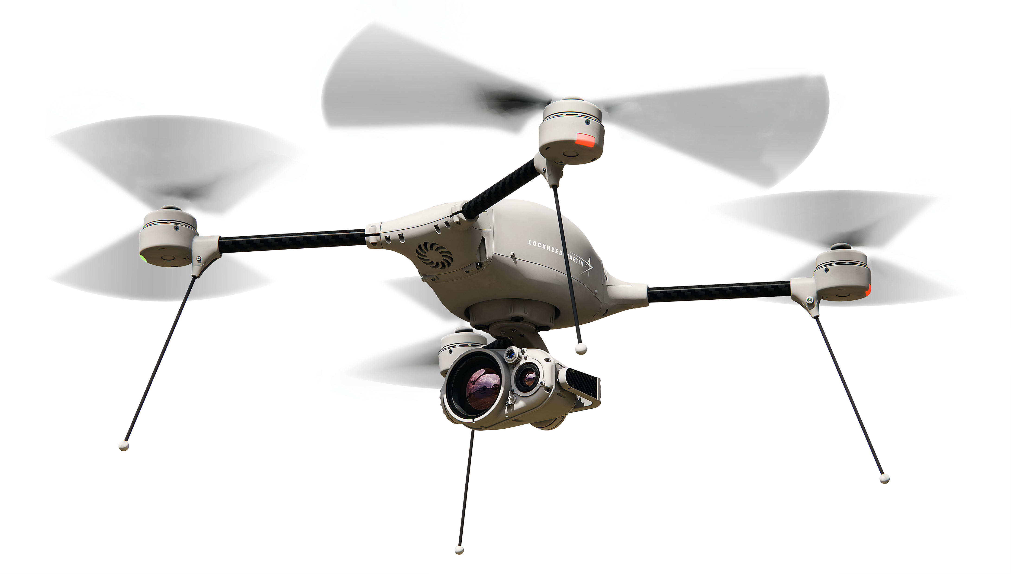

Autonomous Mission Operation Project by Tello
TEAM.
Archaeopteryx (시조새)
MEMBER.
장보현, 이상재, 정민조
ⓒ Lockheed Martin

Slide 2
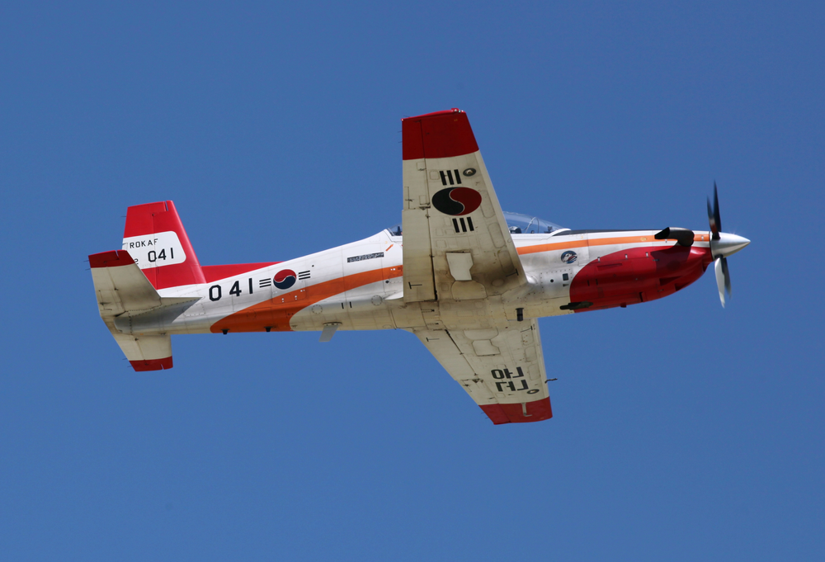
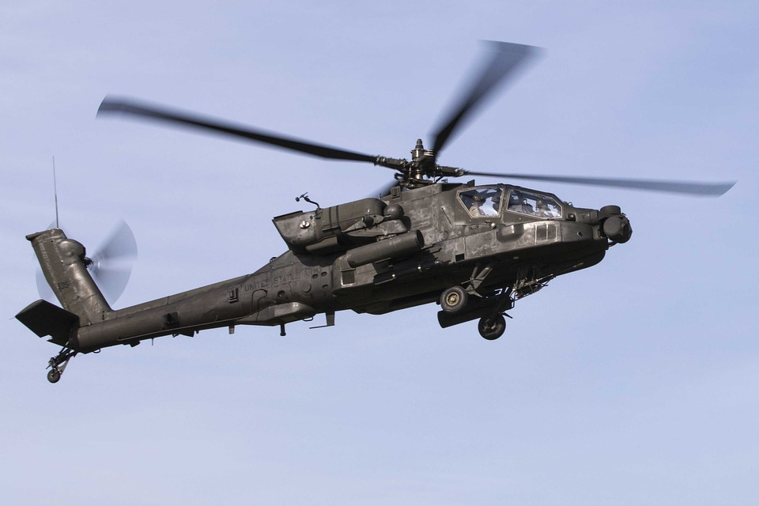
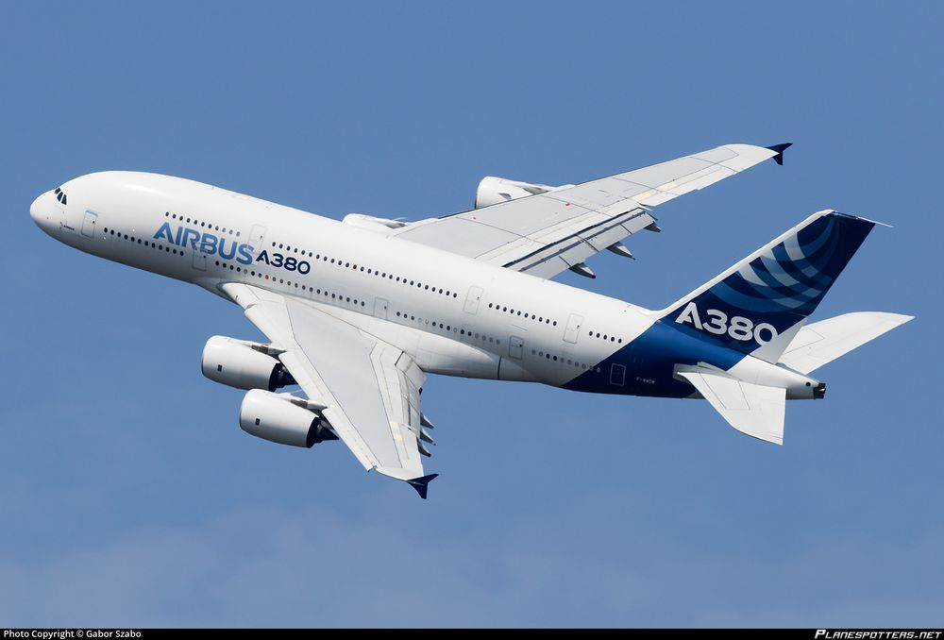

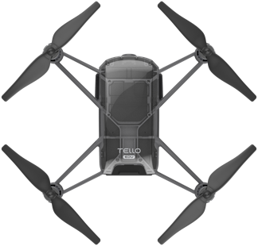
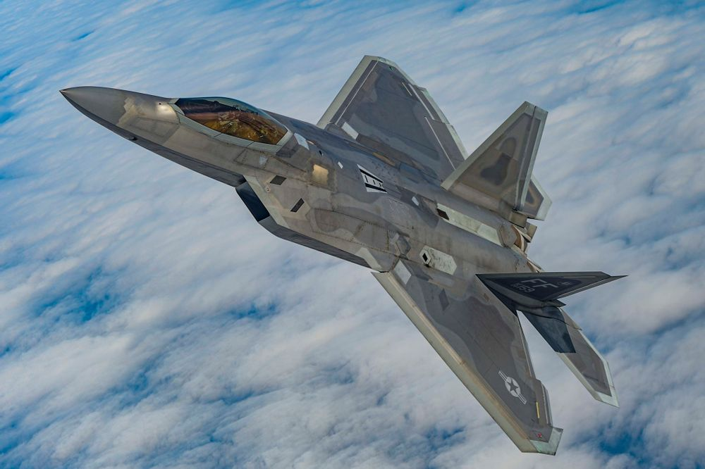
1. Mission Specification
1. Flag
2. Tracking
3. Landing
Landing
Point
R
Landing
Point
B
3.6m
Landing
Point
B
Landing
Point
QR
7.8m
ⓒ Korea Aerospace University, Namu wiki, Ryzerobotics

Slide 3
2. Control System Structure
Perception
Guidance
Navigation & Control
Mission State
Update
Mission State
PD Control Algorithm
Calculate distance error from Marker information.
Feedback control via RC control input.
Front
Cam
Noise Filter
Image Feedback Control
Roll
Pitch
Yaw
Throttle
+
Flip
Mission Process
Tello Dynamics
Marker Recognition
OpenCV
YOLO algorithm
Marker
Information
Center, Radius
Etc.
Thread Control
Thread Function
Operate pre-coded drone dynamic function in threads.
Mission Process
Update
Main Feedback Loop (FPS)

Slide 4
3. Perception
Mission State
Object
Detect Method
Desire Info.
0, 1 ,2
Colored Circle Flag
OpenCV Contour Detection
+
Average Color inside the Contour
Center Coordinate
+
Size of the Object
3
KAU Marker
Pretrained YOLOv5m
4
F-22 Photo
Pretrained YOLOv5m

Slide 5
4. Guidance
Simple Kalman Filter
Raw Data from Perception
Select
- Center Coordinate
- Size of the Object
- Path/ Drone Attitude
- Control Mode
+
Mission Process
Filtered Target Data
- Center Coordinate
- Size of the Object

Slide 6

5. Navigation & Control
Tello Dynamics
Mission Process
Image Feedback PD Control
RC Commands
0.1 , 0.2
3.1 , 3.2
4.1 , 4.2
Input : $k_{p}∙e+ k_{d}∙\dot{e}$
Make desire point to place at the center of the Tello image frame
Roll
Pitch
Throttle
Yaw
+
Mission Process
Thread Control
SDK Tello Commands
-1.2
0.3 , 0.4
4.3
Operate Pre-coded Thread Missions
1 ~ 9 Handwritten Digit Missions
ex) move_up,
flip_forward

Slide 7
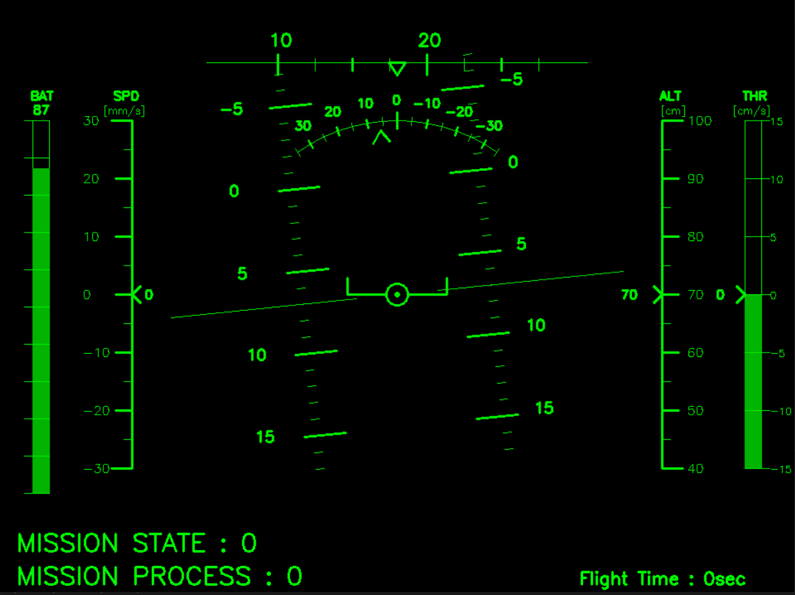
6. HUD(Head Up Display)
Yaw Indicator
[deg]
Airspeed Indicator
[mm/s]
Altimeter
[cm]
Battery
[%]
Vertical-Speed
Indicator
[cm/s]
Roll Indicator
[deg]
Pitch Ladder
[deg]
Mission State
Mission Process
Flight Time
[sec]

Slide 8
THANK YOU!
TEAM
Archaeopteryx (시조새)
ⓒ Lockheed Martin

